Slide 1
Coding concept activity sheets

Slide 2
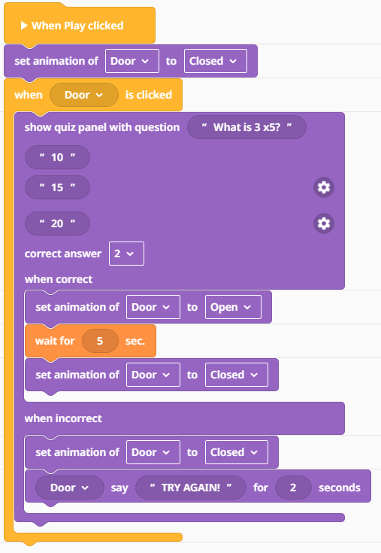

Coding concept: Inputs and triggers
Using the Quiz Panel code block. Create a question where the player must INPUT the correct answer to TRIGGER (start) the door to open.
Notes:
Deploy this link Via Google Classroom for the template:
https://edu.delightex.com/DSF-FAL

Slide 3
Coding concept: Inputs and triggers
Using the Quiz Panel code block. Create a question where the player must INPUT the correct answer to TRIGGER (start) the door to open.
Notes:
Deploy this link Via Google Classroom for the template:
https://edu.delightex.com/DSF-FAL

Slide 4

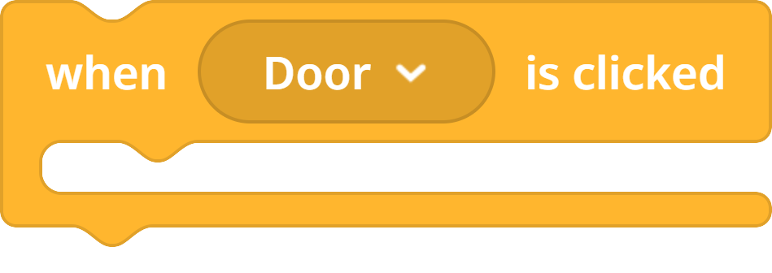
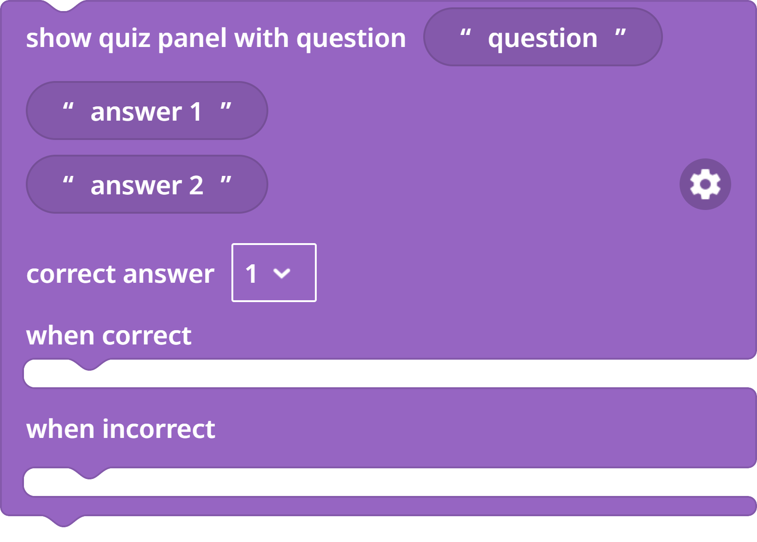


Coding concept: Inputs and triggers
Using the Quiz Panel code block. Create a question where the player must INPUT the correct answer to TRIGGER (start) the door to open.
Notes:
Deploy this link Via Google Classroom for the template:
https://edu.delightex.com/DSF-FAL

Slide 5
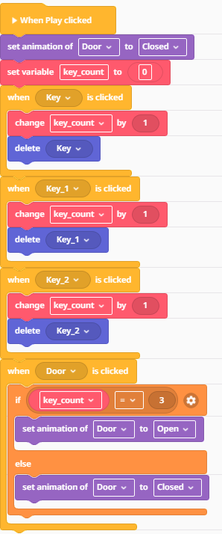
Coding concept: Variables and conditionals
You need to create a VARIABLE called ‘Key Count’.
Using the IF THEN ELSE code block and make the door open when you collect the 3 keys.
Use an OPERATOR to TRIGGER something to happen when key count = 3
Notes:
TEMPLATE Deploy template to Google Classroom: https://edu.delightex.com/CZN-NFU
WAGOLL https://edu.delightex.com/CZN-NFU

Slide 6
Coding concept: Variables and conditionals
Notes:
Deploy template to Google Classroom: https://edu.delightex.com/CZN-NFU

Slide 7

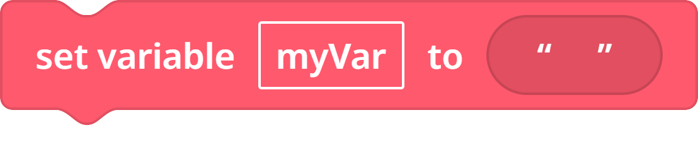

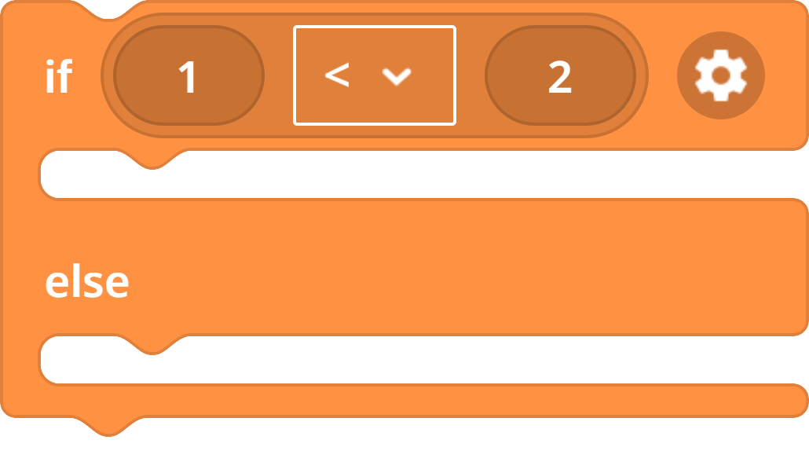

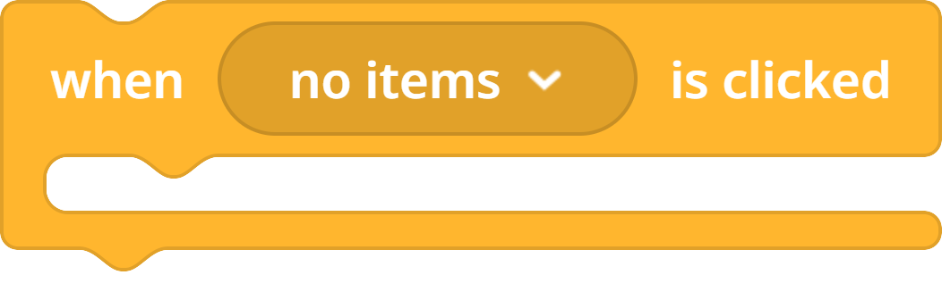

Coding concept: Variables and conditionals
You need to create a VARIABLE called ‘Key Count’.
Using the IF THEN ELSE code block and make the door open when you collect the 3 keys.
Use an OPERATOR to TRIGGER something to happen when key count = 3
Notes:
Deploy template to Google Classroom: https://edu.delightex.com/CZN-NFU

Slide 8
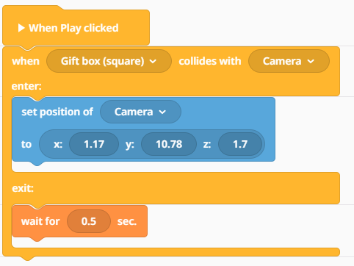
Coding concept: Collision triggers and transforming
Code the camera to teleport to new position (XYZ) when it collides with the gift box.
You need to find out the coordinates of the new position and type them into the ‘Set position block’
Notes:
Deploy the template via Google Classroom https://edu.delightex.com/CDY-TMS

Slide 9
Coding concept: Collision triggers and transforming
Code the camera to teleport to new position (XYZ) when it collides with the gift box.
You need to find out the coordinates of the new position and type them into the ‘Set position block’
Notes:
Deploy the template via Google Classroom https://edu.delightex.com/CDY-TMS

Slide 10
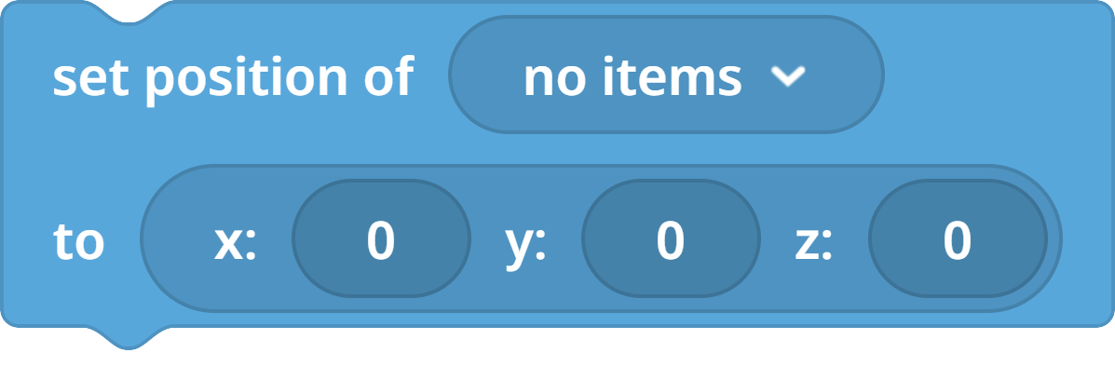
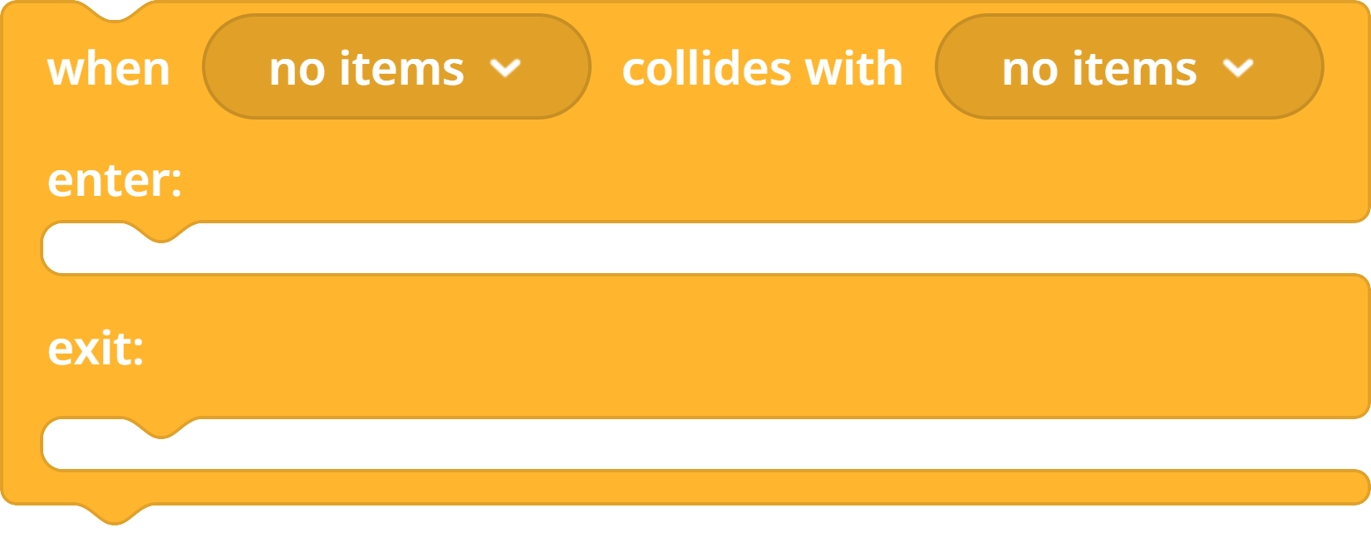
Coding concept: Collision triggers and transforming
Code the camera to teleport to new position (XYZ) when it collides with the gift box.
You need to find out the coordinates of the new position and type them into the ‘Set position block’
Notes:
Deploy the template via Google Classroom https://edu.delightex.com/CDY-TMS

